Slide 1

Dubai Real Estate Intelligence Dashboard
Created By: Ayush Dash
Date:12-04-2026

Slide 2

CONTENTS
01
Project Overview
02
Data Preparation
PART
PART
03
Dashboard Architecture
04
Advanced Analytics
PART
PART
05
Strategic Insights
06
Conclusion
PART
PART

Slide 3

PART 01
Project Overview

Slide 4


Project Objective
Core Objectives
Analyze Dubai housing data to identify price trends and property distribution. Build an interactive Power BI dashboard to provide actionable insights for investors, agents, and policymakers.

Slide 5

Dataset Overview
Data Structure
The dataset "Housing_price_dataset.csv" includes essential columns: SquareFeet, Bedrooms, Bathrooms, Neighborhood, YearBuilt, and Price. This data forms the foundation for the dashboard's analytical capabilities.

Slide 6
PART 02
Data Preparation

Slide 7

Data Transformation
Calculated Columns
Created calculated columns to enhance analysis: PricePerSqft, PropertyAge, ListingCategory, PropertyType, Developer, FurnishingStatus, and Location. These columns allow for deeper segmentation and trend analysis.

Slide 8

Measures Created
Key Metrics
Defined essential measures for the dashboard: Average Price, Avg Price per Sqft, Avg Size, Max Price, Total Listings, and Oldest Property. These metrics drive the KPI cards and visualizations.

Slide 9
PART 03
Dashboard Architecture

Slide 10

Dashboard Structure
Navigation Flow
The dashboard is structured into three main pages: Home Page, Overview Page, and Insights Page. This design ensures intuitive navigation and focused data exploration.

Slide 11
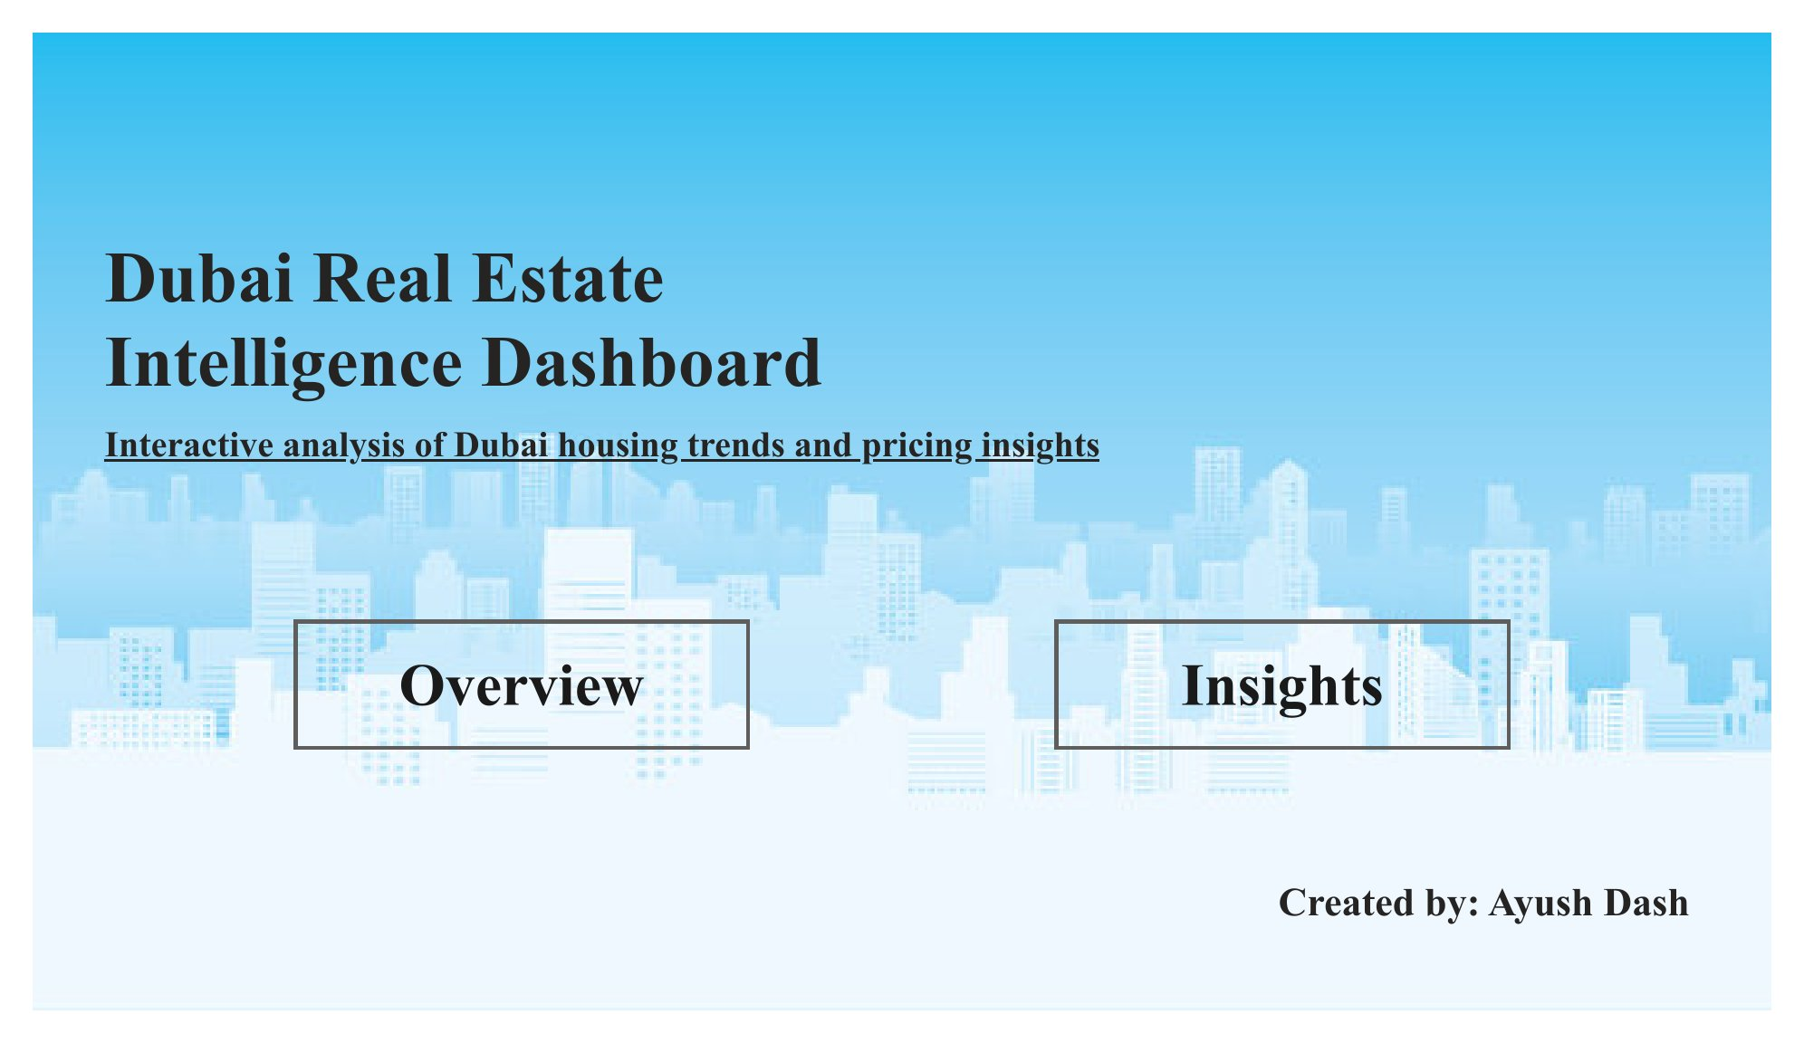

Home Page
Navigation Interface
The Home Page serves as the entry point, featuring navigation buttons for "Overview" and "Insights." This provides users with direct access to the dashboard's core analytical sections.

Slide 12

Overview Page
Visual Overview
The Overview Page displays KPI Cards for Total Listings, Avg Price, Avg Price/Sqft, and Property Age. It includes a Bar Chart for Listings by Neighborhood, Pie Charts for Property Type, Category, and Furnishing, plus a Neighborhood Slicer.

Slide 13
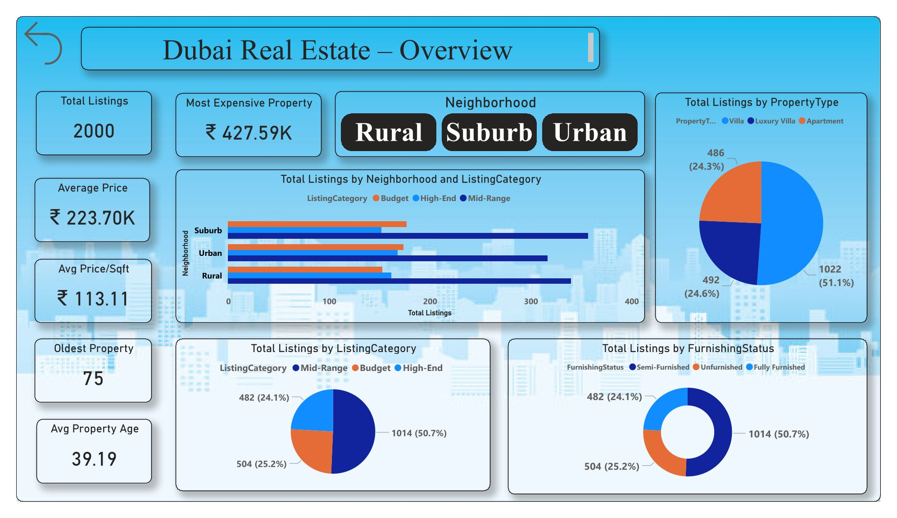
Overview Page ScreenShots

Slide 14


Insights Page
Detailed Analysis
The Insights Page features KPI Cards for Avg Bedrooms, Avg Bathrooms, and Avg Price. It includes a Scatter Plot for Price vs. SquareFeet, Pie Charts for Furnishing Status and Listing Category, and a Stacked Bar Chart for Top 5 Neighborhoods by Price.

Slide 15
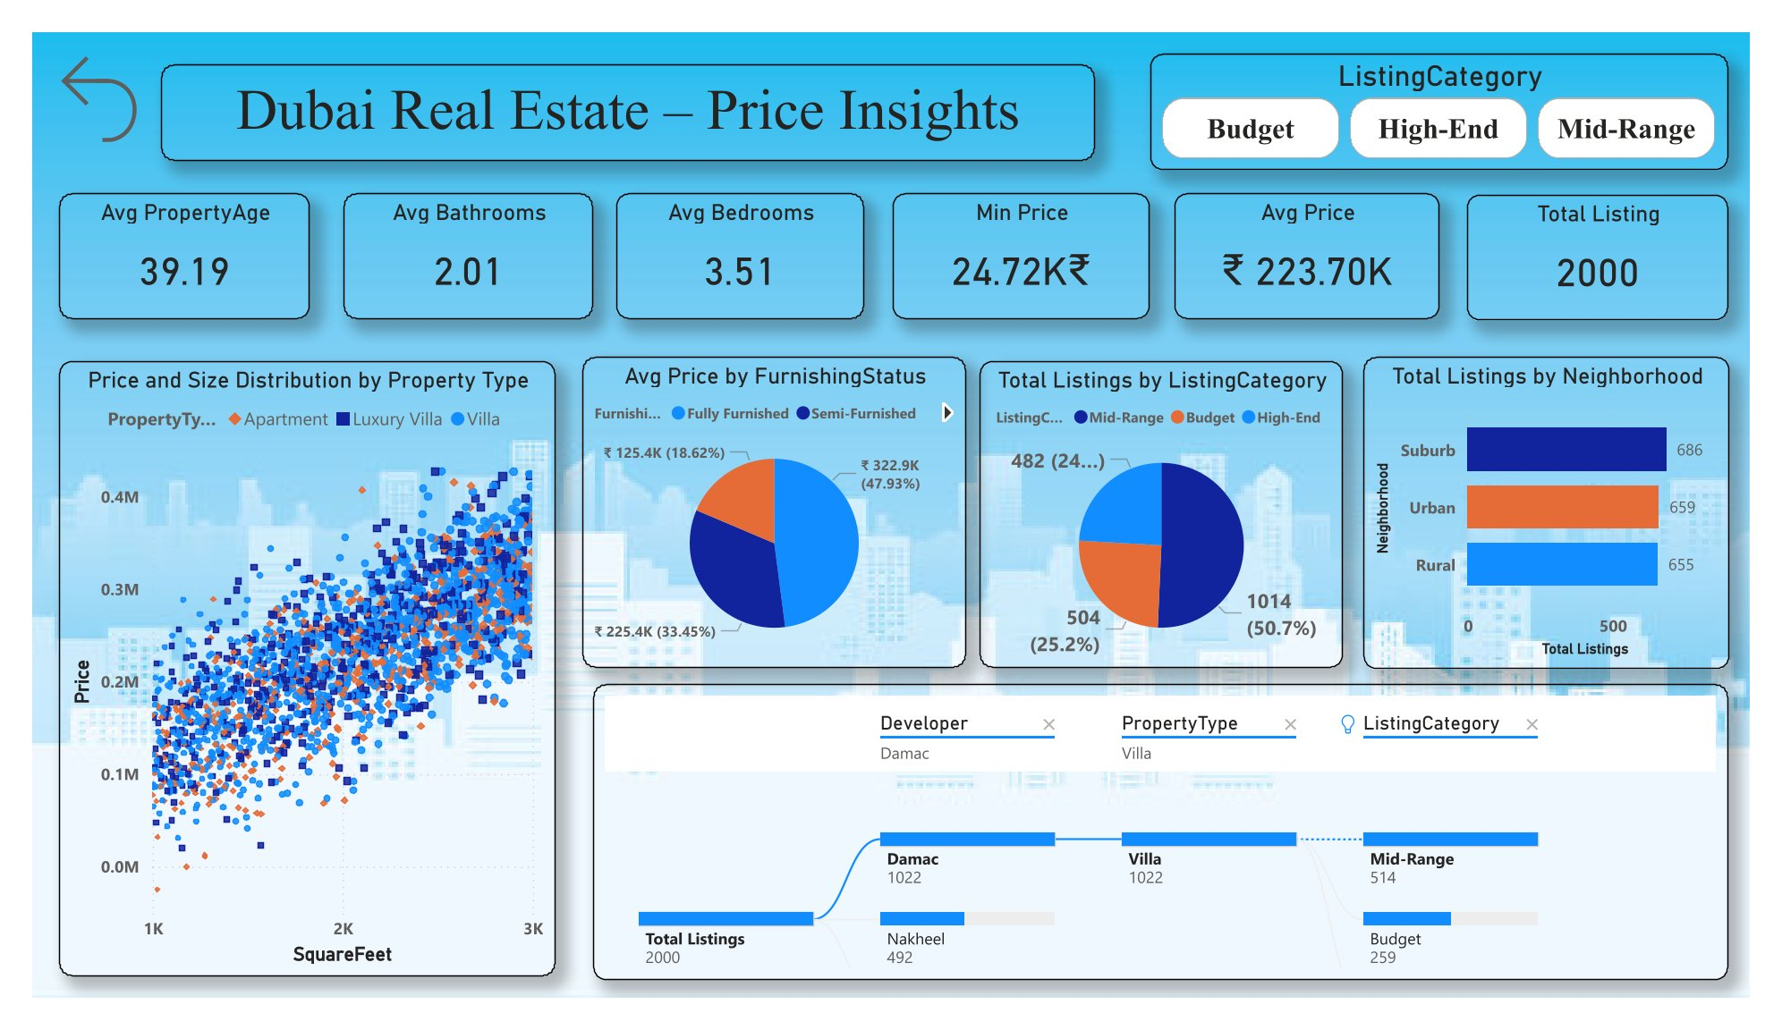
Insights Page ScreenShots

Slide 16
PART 04
Advanced Analytics

Slide 17
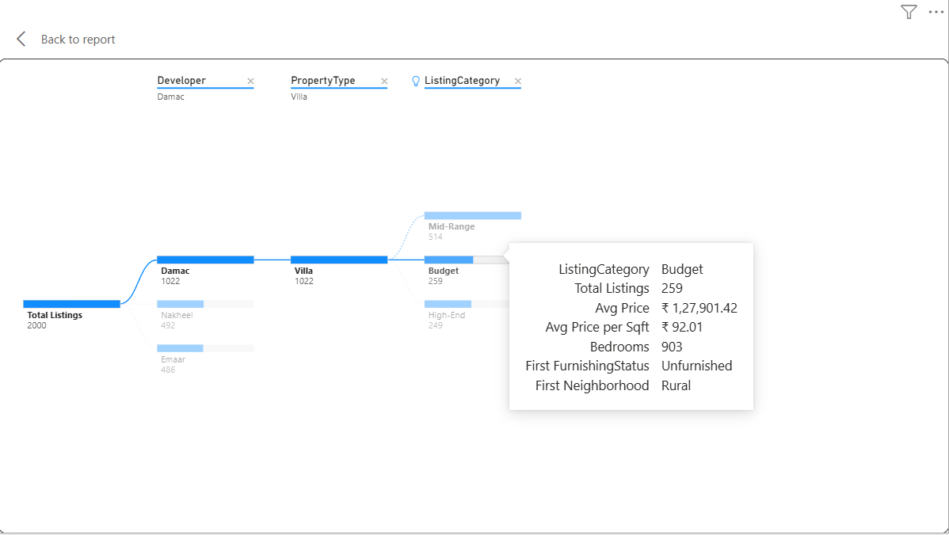
Advanced Visuals
Tree Map Analysis
A Tree Map visualizes Total Listings, explained by Developer and Property Type. Tooltips provide detailed data on Price, SquareFeet, and Bedrooms, offering a comprehensive view of property distribution.

Slide 18
PART 05
Strategic Insights

Slide 19

Key Insights
Market Trends
Analysis reveals that high-end properties generate higher revenue, and price increases with square footage. Premium neighborhoods show higher demand, while Apartments dominate total listings.

Slide 20

Business Recommendations
Actionable Advice
Investors should focus on high-end properties for better returns. Agents can target high-demand neighborhoods, and developers should build more mid-range housing. Pricing strategies must consider price per sqft trends.

Slide 21
PART 06
Conclusion

Slide 22

Final Thoughts
Summary
The interactive dashboard successfully derives insights from real estate data. It supports better decision-making for stakeholders, providing a robust tool for navigating the Dubai real estate market.

Slide 23
Thank You

